Slide 1

Multilayer RNN on MNIST

Slide 2

Reference
Chapter 14 (O'Reilly) of Hands-On ML
Youtube on MNIST
Youtube on CNN on MNIST
Youtube on RNN on MNIST
Youtube
Code

Slide 3
Data

Slide 4
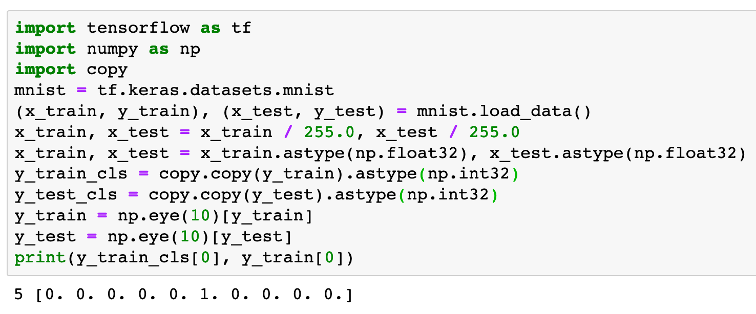

Slide 5
Warm Up

Slide 6
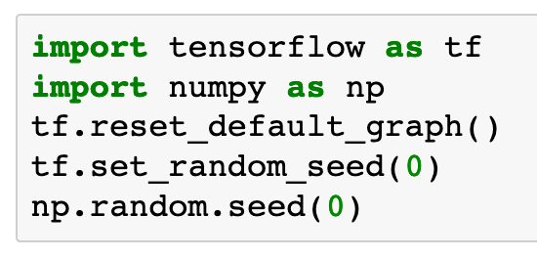

Slide 7
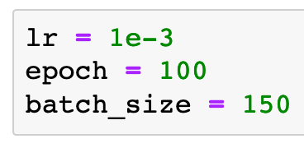

Slide 8
Graph

Slide 9
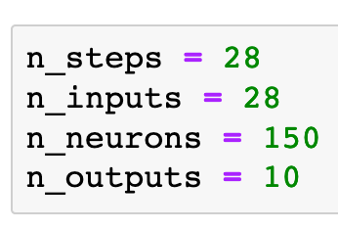
Previously

Slide 10
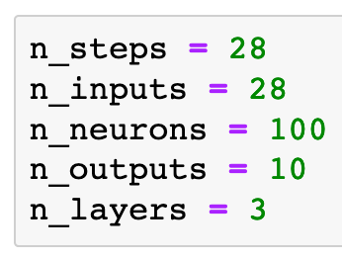
Previously
Now

Slide 11
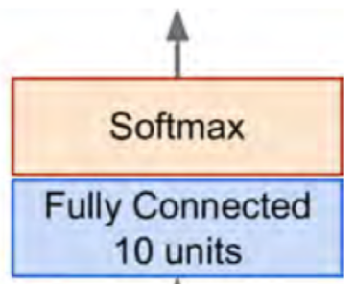
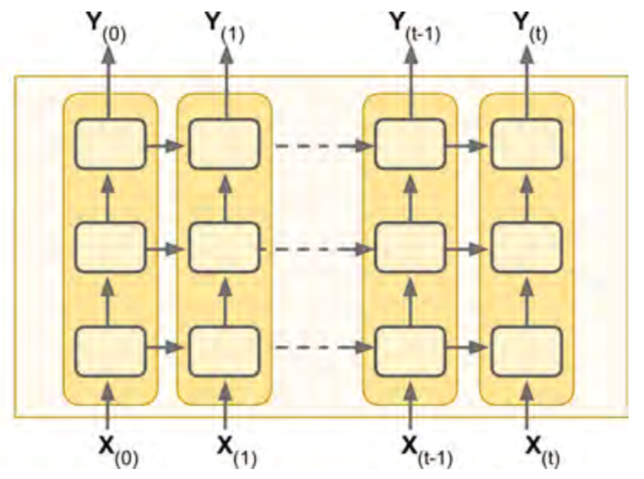
Previously
Now
Chapter 14 (O'Reilly) of Hands-On ML

Slide 12
Chapter 14 (O'Reilly) of Hands-On ML

Slide 13


Chapter 14 (O'Reilly) of Hands-On ML

Slide 14

Chapter 14 (O'Reilly) of Hands-On ML

Slide 15
Chapter 14 (O'Reilly) of Hands-On ML

Slide 16
Chapter 14 (O'Reilly) of Hands-On ML

Slide 17

Chapter 14 (O'Reilly) of Hands-On ML

Slide 18
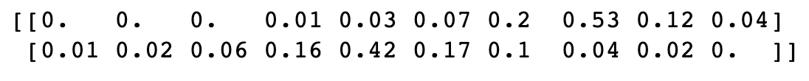
Chapter 14 (O'Reilly) of Hands-On ML

Slide 19
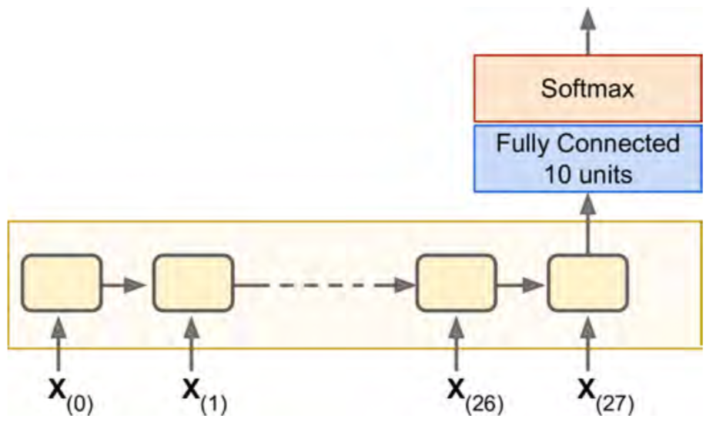
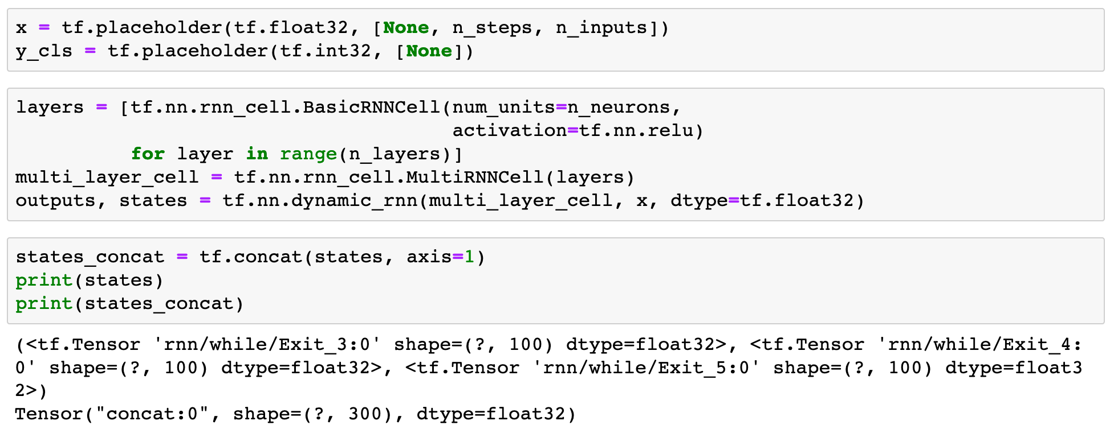

Chapter 14 (O'Reilly) of Hands-On ML

Slide 20
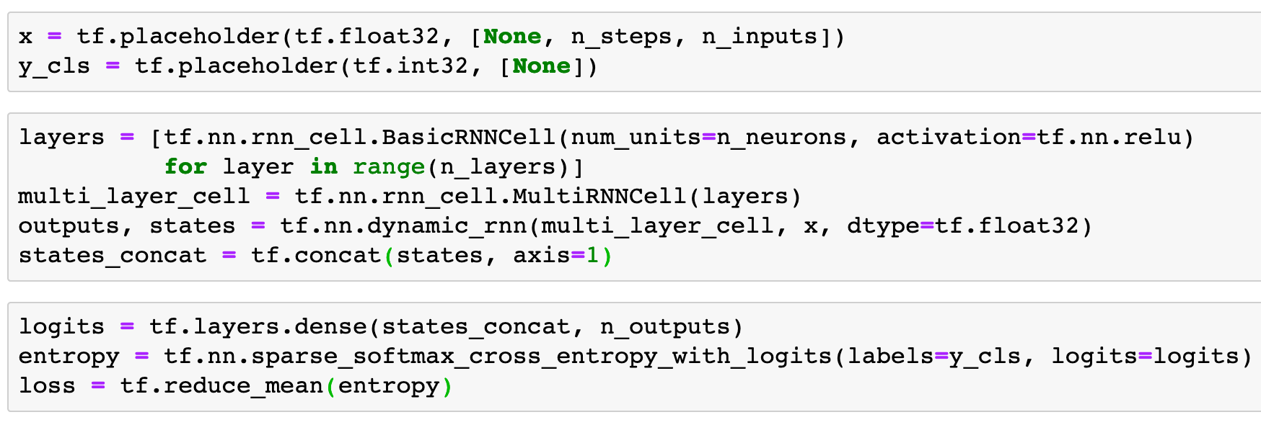
Chapter 14 (O'Reilly) of Hands-On ML

Slide 21
Chapter 14 (O'Reilly) of Hands-On ML
x

Slide 22
Chapter 14 (O'Reilly) of Hands-On ML
(?,28,28)
x

Slide 23
Chapter 14 (O'Reilly) of Hands-On ML
(?,28,28)
x

Slide 24

Chapter 14 (O'Reilly) of Hands-On ML
states
(?,28,28)
x

Slide 25
Chapter 14 (O'Reilly) of Hands-On ML
states
tuple of tensors
(?,28,28)
x

Slide 26
Chapter 14 (O'Reilly) of Hands-On ML
states_concat
states
tuple of tensors
(?,28,28)
x

Slide 27
Chapter 14 (O'Reilly) of Hands-On ML
(?,300)
states_concat
states
tuple of tensors
(?,28,28)
x

Slide 28
Chapter 14 (O'Reilly) of Hands-On ML
(?,300)
states_concat
states
tuple of tensors
(?,28,28)
x

Slide 29
Chapter 14 (O'Reilly) of Hands-On ML
logits
(?,300)
states_concat
states
tuple of tensors
(?,28,28)
x

Slide 30
Chapter 14 (O'Reilly) of Hands-On ML
(?,10)
logits
(?,300)
states_concat
states
tuple of tensors
(?,28,28)
x

Slide 31
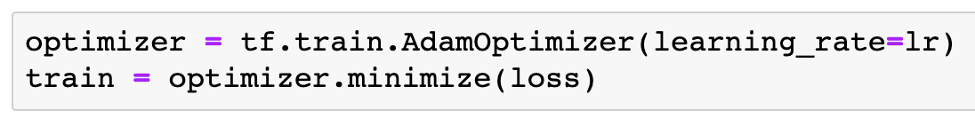

Slide 32
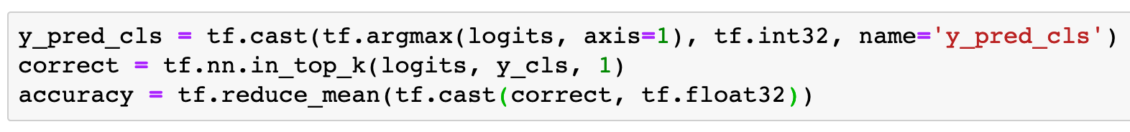

Slide 33
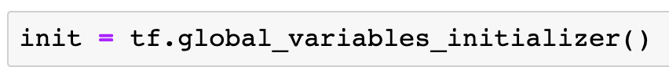

Slide 34
Session

Slide 35
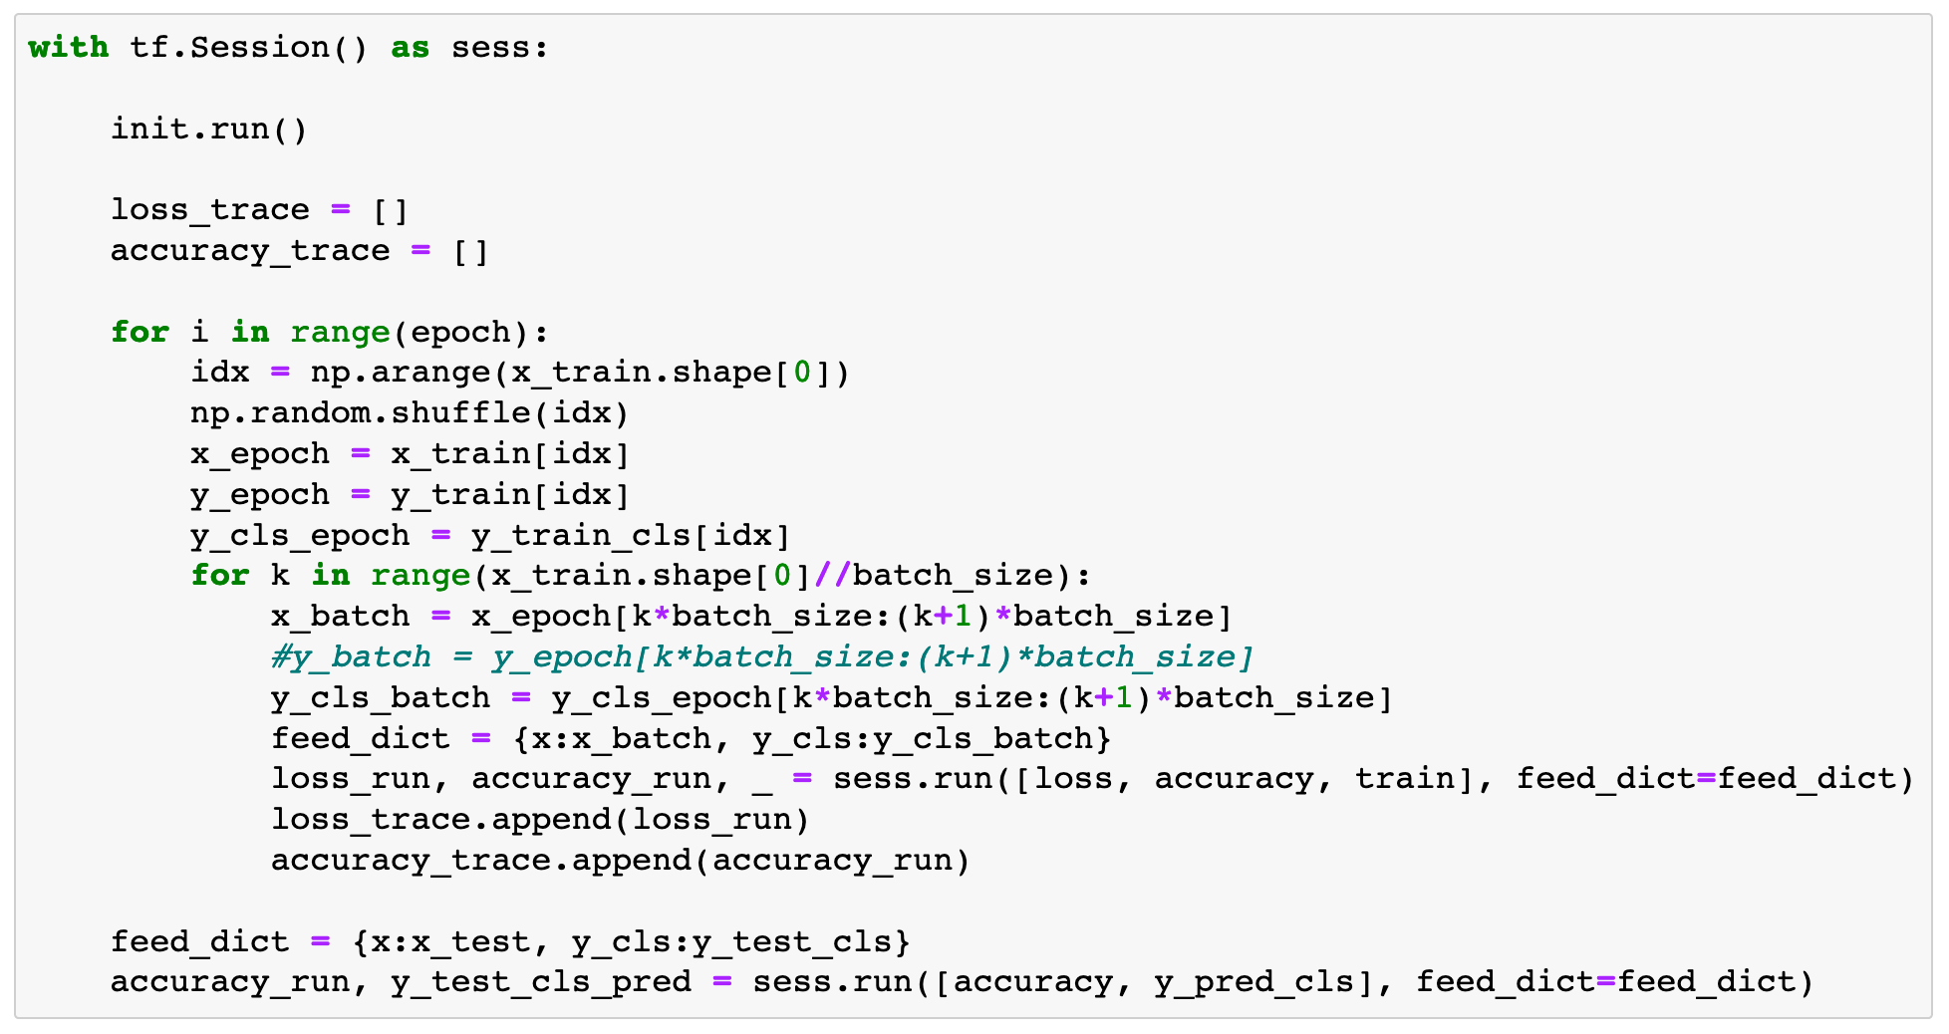

Slide 36
Report Result

Slide 37
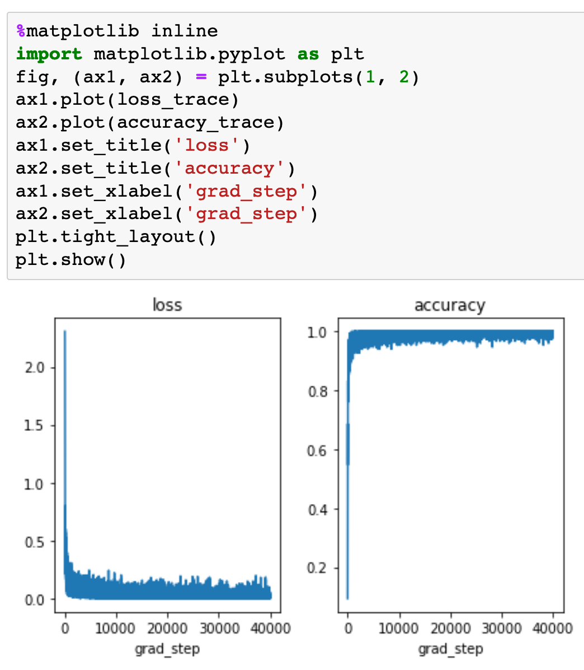

Slide 38
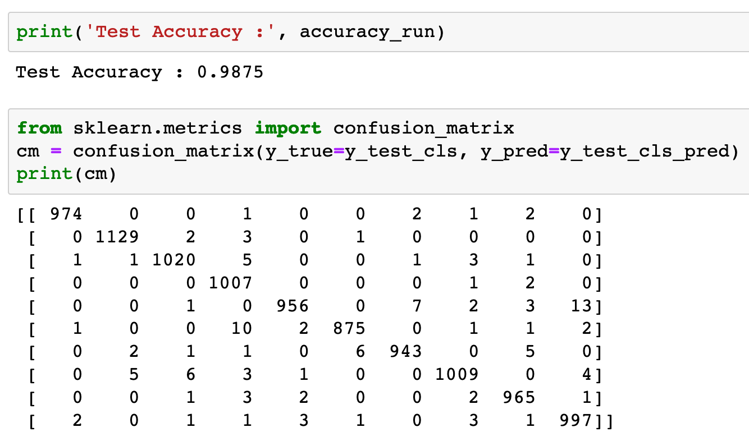


Slide 40
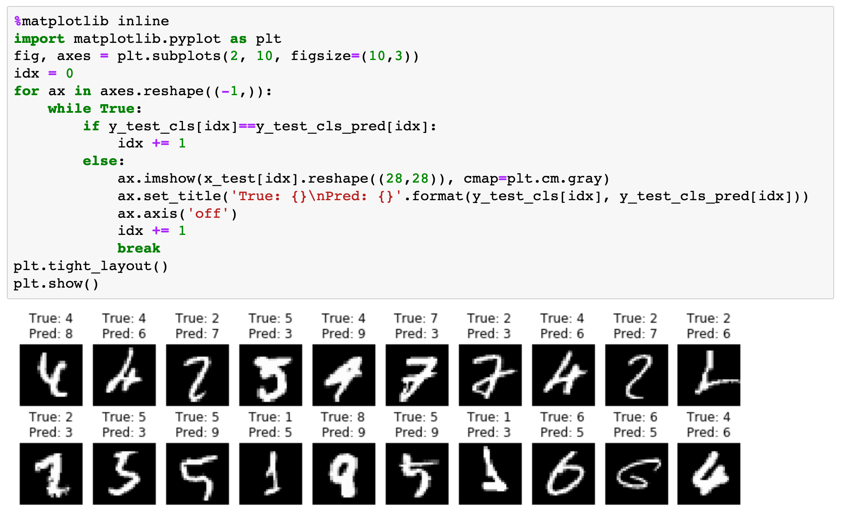

Slide 41
Now
Let’s Play with Code

